Slide 1
Schade Model Run Network Comparisons

Slide 2
Model Runs
Schade Data
Change format only
Change optimization parameters (OP)
alpha=0.02, maxiter=1.00E+08, tolFun=1.00E-06, MaxFunEval=1.00E+08, TolX=1.00E-06
Add replicate data, change OP
Neymotin production and degradation rates, change OP, no replicate data
Neymotin production and degradation rates, change OP, add replicate data
Dahlquist Data
Schade network, Neymotin production and degradation rates, change OP
*Edge weight Normalization factor for each network was set to 2.971

Slide 3
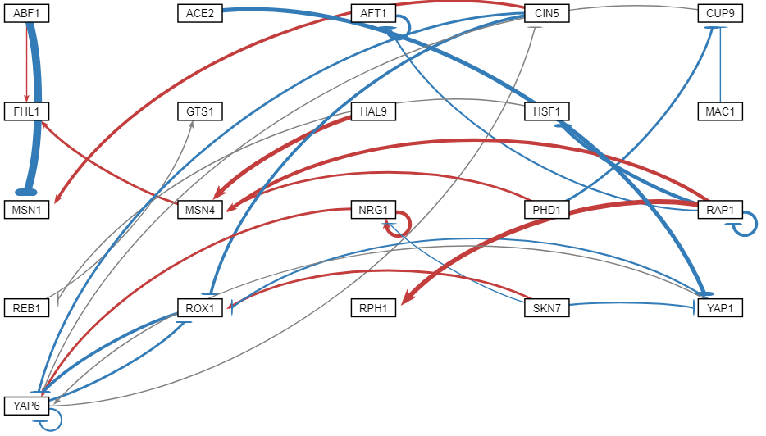
Schade network, data, GRNsight demo

Slide 4
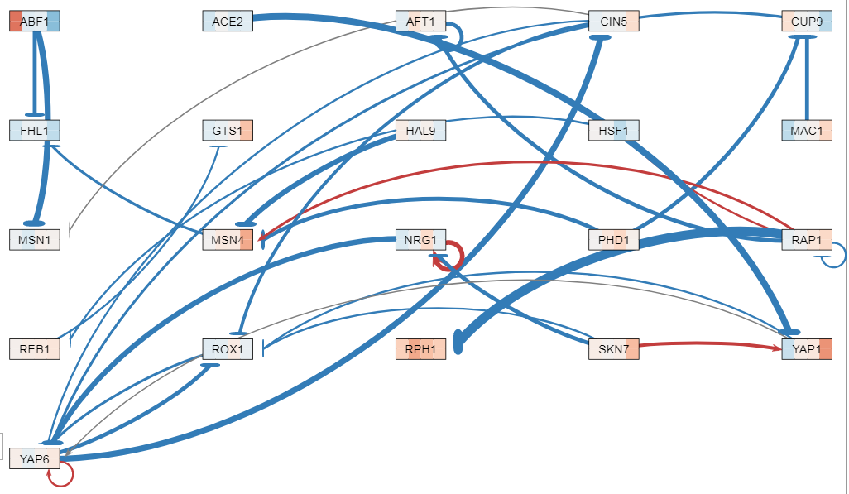
Schade network, changed format

Slide 5
Schade network, data, GRNsight demo

Slide 6
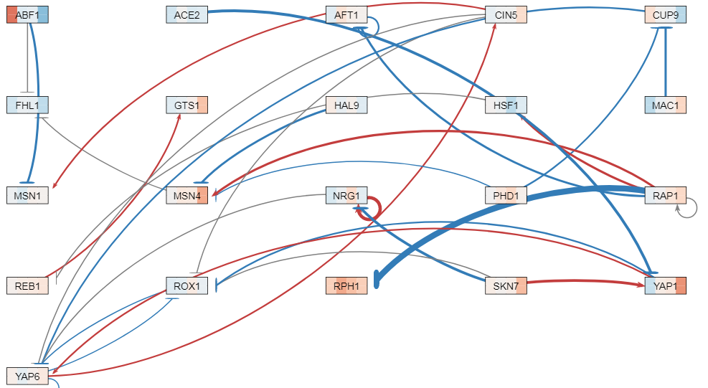
Schade network, change optimization parameters
alpha=0.02, maxiter=1.00E+08, tolFun=1.00E-06, MaxFunEval=1.00E+08, TolX=1.00E-06

Slide 7
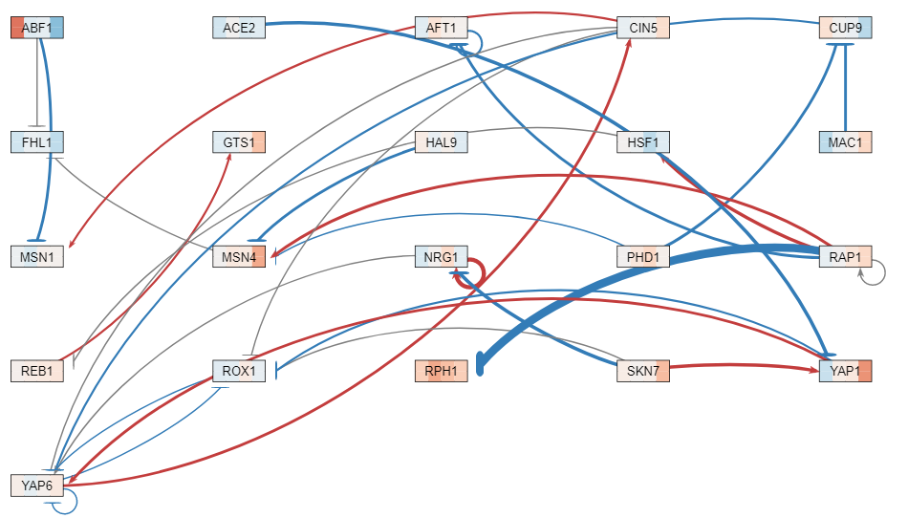
Schade network, Replicate data added, optimization parameters changed

Slide 8
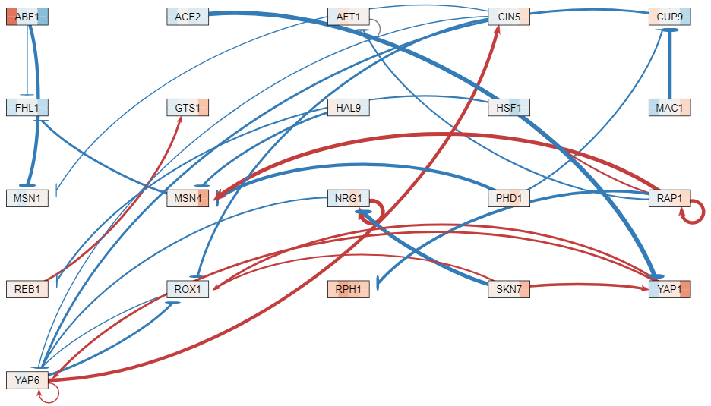
Schade network, Neymotin production and degradation rates, no replicate data, optimization parameters changed

Slide 9
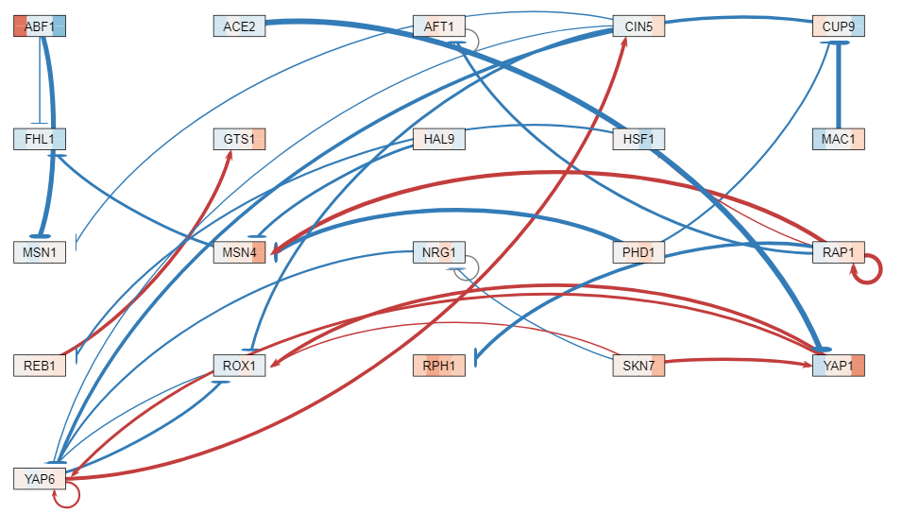
Schade network, Neymotin production and degradation rates, replicate data, optimization parameters changed

Slide 10
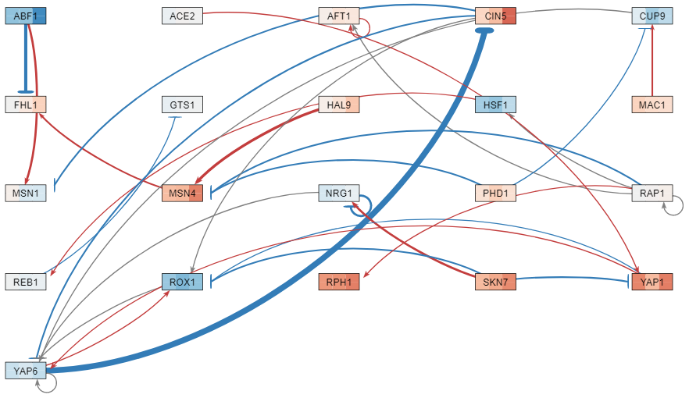
Schade network, Dahlquist wt-only data, Neymotin production and degradation rates, optimization parameters changed

